Slide 1


Workers’ Compensation Fundamentals
&
Coverage Requirements
April 23, 2019
Presented by
Vivian R. Lane & Suzanne Soule

Slide 2
Agenda
Workers’ Compensation – Fundamentals
Covered Injuries and Claims
Virginia Coverage Requirements
Rejection of Coverage – Form 16A
Independent Contractor vs. Employee
Across State Lines
Insurance Regulation
The Safety Factor
Penalty Considerations

Slide 3

Workers’ Compensation – Fundamentals
For Workers, workers’ compensation provides…
Prompt, but limited benefits:
  Indemnity benefits
  Lifetime medical benefits
  Permanent disability benefits
  Cost of living supplements

Slide 4
Workers’ Compensation – Fundamentals
Worker must file a claim within the appropriate statute of limitations:
  Injury by accident
    2 years from date of accident
    §65.2-601
  Disease
    Occupational Disease
    Ordinary Disease of Life
    §65.2-400, 401 & 406
    2 years from date of accident or 5 years of last exposure

Slide 5
Workers’ Compensation – Fundamentals
Indemnity Benefits include:
Temporary Partial and Temporary Total
  66⅔ percent of the average weekly wages
  Undocumented workers ineligible for TPD
  500 week maximum
Fatal
  Wage replacement benefits, funeral expenses and transportation
  Spouse until remarriage
  Dependents until 23 yrs old
  Expenses reimbursed:
    $10,000 - burial
    $1,000 - transportation of body
Permanent Total
  Lifetime wage replacement
  No 500 week maximum

Slide 6

Workers’ Compensation – Fundamentals
Lifetime Medical Benefits include:
Transportation
  Reasonable and necessary transportation costs
Panel of physicians
  Panel of at least three physicians
Diagnosis and treatment
  Payment for expenses related to injury or occupational disease
Vocational Rehabilitation
  Reasonable and necessary vocational rehabilitation

Slide 7

Workers’ Compensation – Fundamentals
Permanent Disability Benefits include:
Loss of vision
  Found in Rule 13 of the Act
Loss of hearing
  Found in Rule 12 of the Act
Amputation
  Amputation chart provides percentage of loss of a body part
Disfigurement/Scarring
  Clear, color photographs or in-person viewing
Permanent Partial
  Impairment rating provides loss of use of a body part

Slide 8
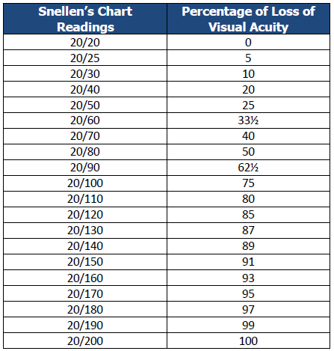
Vision Loss (Rule 13)
Loss of Vision
The percentage of visual acuity is based on the Snellen’s Chart (Rule 13)
If the injured worker had pre-existing loss of vision, it is subtracted from the post injury reading prior to determination of the percentage of loss.

Slide 9
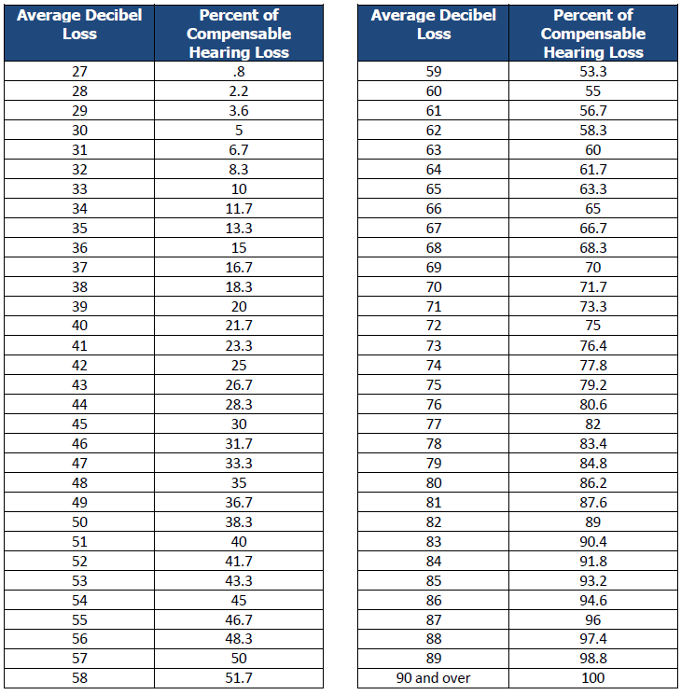
Hearing Loss Table (Rule 12)

Slide 10
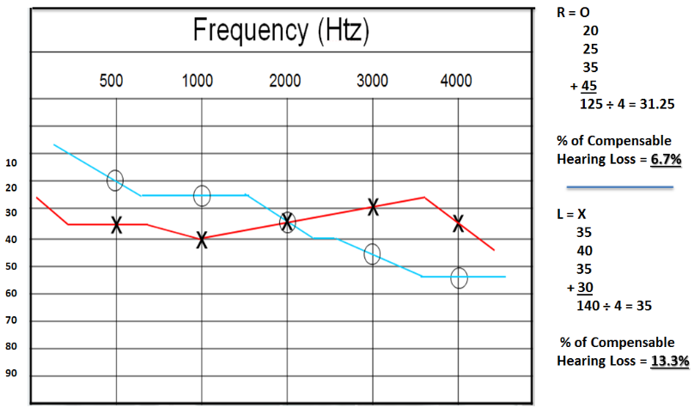
Audiogram Example

Slide 11
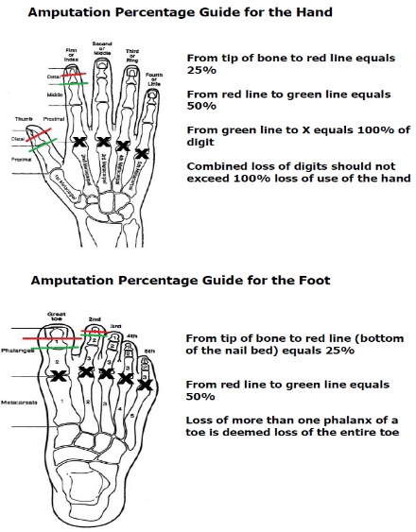
Permanent Disability Benefits - Amputation
Amputation

Slide 12
Permanent Partial Disability §65.2-503
Loss | Compensation Period
Thumb | 60 weeks
First finger (index finger) | 35 weeks
Second finger | 30 weeks
Third finger | 20 weeks
Fourth finger (little finger) | 15 weeks
First phalanx of the thumb or any finger is equal to one-half compensation for loss of entire thumb or finger. Loss of more than one phalanx of a thumb or any finger is deemed the loss of the entire thumb or finger. Amounts received for loss of more than one finger shall not exceed compensation provided for loss of a hand.
Great toe | 30 weeks
A toe other than a great toe | 10 weeks
First phalanx of any toe is equal to one-half compensation for loss of entire toe.
Loss of more than one phalanx of a toe is deemed loss of the entire toe.
Hand | 150 weeks
Arm | 200 weeks
Foot | 125 weeks
Leg | 175 weeks
Permanent loss of vision of an eye | 100 weeks
Permanent loss of hearing of an ear | 50 weeks
Severely marked disfigurement of the body | not exceeding 60 weeks
First stage of pneumoconiosis, silicosis & asbestosis | 50 weeks
Second stage of pneumoconiosis, silicosis & asbestosis | 100 weeks
Third stage of pneumoconiosis, silicosis & asbestosis | 300 weeks
Byssinosis | 50 weeks
Calculating PPD
% (rating) x number of weeks for body part x compensation rate = total amount due to the injured worker

Slide 13

Workers’ Compensation – Fundamentals
For Employers - workers’ compensation provides…
A shield from civil suit:
  Benefit payout is limited to statutory benefits
  No payment for:
    Pain and suffering
    Loss of Consortium
    Loss of Enjoyment of Life
    Punitive Damages

Slide 14
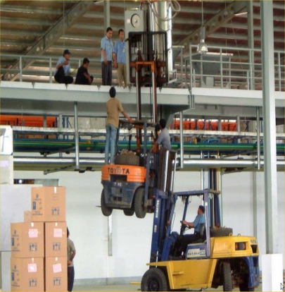
Workers’ Compensation – Fundamentals
Workers’ compensation is No Fault insurance
Employer may
  Be negligent
  Provide unsafe work conditions
  Provide inadequate training or supervision
Employee may
  Be careless or negligent

Slide 15
Covered Injuries and Claims

Slide 16
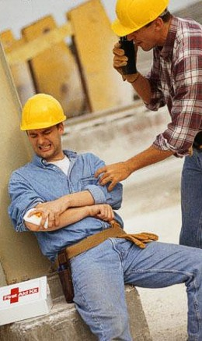
Covered Injuries
Not all injuries that occur at work are covered injuries
Work injury is covered only if it arises out of and in the course of employment
Worker has the burden to prove
  An identifiable incident or event
  Causing an obvious sudden change
  Must trace injury to a definite time,
  place or circumstance

Slide 17

Claim Handling
In the event of a claim a Claims Adjuster takes all action on behalf of the Employer…
The Claims Adjuster:
  Accepts or denies the claim
  Can pay voluntarily
  Communicates with worker
  Communicates with physician
  Adjusts claim
  Can settle claim
Employer has little to no say in claim handling.

Slide 18

Claims Adjuster Claim Denials
The Claims Adjuster can deny claims
  Injured worker’s burden of proof to prove claim
  Injured worker must also file claim forms for each benefit
Law provides for denial of:
  Willful misconduct
  Intentional self-injury
  Intentional injury to another
  Intoxication
  Use of non-prescribed drug
  Willful failure to follow
  employer’s reasonable rules

Slide 19
Violation of a Safety Rule
Failure to follow an employer’s safety rule is a common reason for claim denial
Employer and carrier’s burden to demonstrate that the:
    Rule was reasonable
    Rule was known to the employee
    Rule was for the employee’s benefit
    Employee intentionally engaged in a forbidden act

Slide 20
In the Event of an Injury…
Ensure that injured worker obtains prompt medical care and treatment:
  Encourage medical treatment, if needed
  Prompt care can reduce costs in the long run
  Seek emergency care, if needed
  Provide injured worker a panel of physicians:
    Three physicians
    Not within the same practice or group
    Must be a physician, not a facility
  Gather all relevant facts surrounding work injury
  Promptly report injury using carrier’s preferred method
    Carrier is responsible for reporting injury to Commission

Slide 21

Cost Savers
Employers are sometimes unaware of steps they can take to reduce injuries and costs:
Provide training; workplace safety
Provide Return-to-Work program
Support health and wellness efforts for employees
Promote and incentivize a drug free workplace
Learn from prior injuries
  Offer medical treatment immediately
  Report to your insurance carrier immediately

Slide 22

Claim Prevention
Prevention is the best way to reduce claims
  Identify and eliminate workplace hazards
  Provide personal protective equipment
  Identify training needs, train and reinforce training
    Claims that occur where enforced safety rules were not followed can be denied
  Encourage employees to identify and eliminate workplace hazards
Accidents occur but most are preventable!
  Make workplace safety a priority
  High hazard business should make it higher priority

Slide 23

Return to Work
Create a “Return-to-Work” program
  Can reduce policy cost and earn premium credit
In the event of work injury, an employee’s return to work sooner reduces claim costs
  Do not require full duty, without restrictions
  Offer light duty work for employee with limitations
  Return to work reduces indemnity pay out
  Studies indicate - the longer a worker is out of work the more likely it is they will never return to work

Slide 24
Return to Work
Consider this…
  An employee off work more than six weeks has less than a 50% chance of ever returning to work!
  From the Florida Partnership for Safety and Health with a grant from the Public Entity Risk Institute:
  “…after six weeks of disability there is only a 50% chance that injured workers will return to work. When disabled for a full year, there is only a 1% to 2% chance that injured workers will ever return to work.”
  www.riskinstitute.org/peri/images/file/Chapter8overcomingorganizationalresistance

Slide 25

And…
“Complicating the recovery process are psychological components to injuries. Workers who remain on disability are subject to a condition called “disability syndrome,” which causes them to be unable to return to work even when it is medically feasible. This condition can happen when their ability to be productive is taken away and they sink into depression to go along with the physical pain from the injuries. With such a condition, workers tend to magnify the physical pain until it becomes an immovable obstacle to returning them to work.” -Kirk Hansen, Florida Partnership for Safety and Health

Slide 26
Virginia
Workers’ Compensation
Coverage Requirements

Slide 27
Coverage Requirements
Virginia workers’ compensation coverage requirements are complicated
  Not set out in one place in the law
    Definition § 65.2-101
    Presumption of acceptance of provisions of title; exemptions; notice and rejections § 65.2-300
    Statutory Employer § 65.2-302

Slide 28

Regularly In Service
Coverage is required for more than two employees regularly in service
What does regularly in service mean?
  The number of persons used to carry out the established mode of performing the work of the business is determinative, even though the work may be recurrent instead of constant.

Slide 29
Regularly in Service cont.
Status of the employer does not fluctuate
Employer remain subject to the provisions of the act even if the number of his employees temporarily falls below three
An employer cannot oscillate between coverage and exemption as his workforce exceeds or falls below the minimum from time to time

Slide 30

Employee
Employee is defined broadly in the law. It includes:
  Every person in the service of another
  Any contract of hire, written or implied
  Minors, undocumented workers, apprentices and trainees
  Temporary, seasonal and part-time workers
  Lawfully or unlawfully employed
  Family members
  Executive officers

Slide 31

Employee - Executive Officers
“Executive officer means (i) the president, vice-president, secretary, treasurer or other officer, elected or appointed in accordance with the charter and bylaws of a corporation and
(ii) the managers elected or
appointed in accordance with
the articles of organization or
operation agreement of a limited
liability company.”

Slide 32
Exception: Single Shareholder/Member
A shareholder of a stock corporation having only one shareholder – if not an executive officer
A member of a limited liability company having only one member – if not a Manager
  Under § 65.2-101 (1) (n) a shareholder of a stock corporation having only one shareholder and a member of a LLC having only one member must elect to be included as an employee under the workers’ compensation coverage of the business.

Slide 33

Limited Liability Company – Multiple Members
The law is silent as to multiple members
The Insurance Department’s position is that members will be counted as employees if
  the member(s) performs work and earns wages distinct from their LLC duties

Slide 34

Sole Proprietors and Partner Owners
The Act identifies other individuals that are not employees and can only be covered if the insurer is notified of such election.
  Sole proprietor
  All partners of a business

Slide 35


Coverage Exceptions
Domestic Employment
  A person hired (by the household) primarily for the performance of household duties and chores, the maintenance of the home and the care comfort and convenience of members of the household. A business owner cannot claim this exception.
  No numerical limit on the number of domestic employees

Slide 36
Coverage Exceptions continued
Farm and horticultural laborers – requirements
  Employer with regularly more than three full time employees
Farm
  The Courts have looked to the definition of a “Farming operation” in Black’s: “Tillage of the soil, dairy farming, ranching, production or raising of crops, poultry, or live-stock, and production of poultry or livestock products in an unmanufactured state.”
  Court decisions: a horse training farm and a winery are not “farms”.
Horticultural work
  Involves cultivating fruits, vegetables, flowers and plants; and tilling or fertilizing to prepare for raising crops or plants.
  Court decisions: Landscaping and Lawn Care are not horticultural work.

Slide 37

Coverage Exceptions continued
Volunteer firefighters, lifesaving workers and rescue squad members are uniquely addressed in the Act
  Coverage must be extended by the governing body of the locality in which they work
  The volunteer unit itself can elect to provide coverage

Slide 38

Summary
Be careful to consider how broadly employee
is defined by the law.
  Corporate officers
  Managers
  Temporary or part-timers
  Subcontracting out
  Employees misclassified
    Independent contractor

Slide 39
Statutory Employer Law
Employer is defined broadly under the Statutory Employer law
A business that hires or subcontracts out work is usually required to carry coverage.

Slide 40

Employer continued
Two parts to the Statutory Employer Law
Part A – When a business subcontracts out work that is the same trade, business or occupation, they must include subcontractor’s employees when counting employees to determine
coverage requirements.
Example:
Roofer hires a roofing sub

Slide 41

Employer continued
Two parts to the Statutory Employer Law
Part B – A business that subcontracts out work that is not their own trade, but fulfills part of a contract of their business, must include the subcontractor’s employees when counting employees.
Example:
Homebuilder – subs out
foundation, electrical, etc.

Slide 42

Employer continued
Statutory Employer Law points
  A subcontractor with coverage does not negate the need for a business owner to carry workers’ compensation coverage
  All subcontractors represent exposure to an insurer
  Business owner should request and each subcontractor’s proof of coverage (for audit) for all subcontractors hired
  Owner should not be charged insurance premium for subs that have their own coverage

Slide 43
Rejection of Coverage
Form 16A

Slide 44

Section 65.2-300
“An executive officer may reject coverage . . . for injury or death by accident, but not with respect to occupational disease, if prior to such accident, notice is given to the employer and filed with the Commission. . .”
Form 16A designed to provide
notice

Slide 45

Executive Officer Definition cont.
            Non-compensated officers of corporations exempt from taxation pursuant to Section 501 (c) (3) of Title 26 of the United States Code (Internal Revenue Code of 1954) or (ii) property owners' associations as defined in § 55-509

Slide 46
Executive Officer - Other
Officers must be verified in SCC
For a rejection to be processed with a title other than president, vice-president, secretary or treasurer of a corporation documentation must accompany the 16A form identifying the officer as being elected or appoint as such officer
Directors cannot reject coverage

Slide 47

Executive Officer - Manager
Managers cannot be verified in SCC
Manager(s) rejecting coverage must provide a copy of the articles of organization or operating agreement showing the individual(s) as appointed or elected as Manager(s)

Slide 48
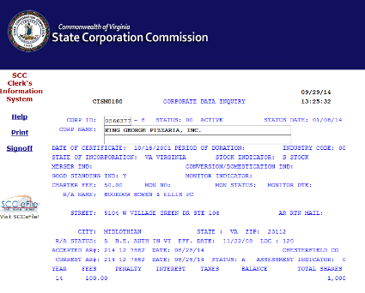
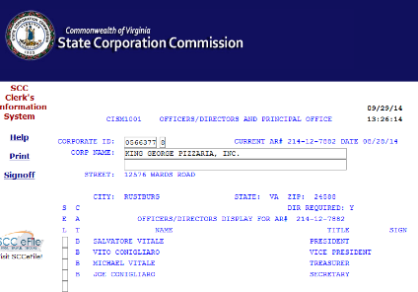
SCC –Clerk’s Information System

Slide 49

Effective Date of Rejection
“. . . notice shall be effective as of the last to occur of (i) the date of the inception of the policy or (ii) the delivery of such notice to the employer”
Example A:
  Officer Signature date 7/1/2015
  Employer Signature date 7/7/2015
  Policy effective date 7/1/2015
  Approval 7/7/2015
Example B:
  Officer Signature date 7/1/2015
  Employer Signature date 6/30/2015
  Policy effective date 7/1/2015
  Approval 7/1/2015

Slide 50
Notification of Approval
The following shall receive copies of approval:
Officer
Carrier
Agent, if applicable
Approval is continuous unless revoked by filing notice with the employer and Commission (17A)

Slide 51
Independent Contractor
vs.
Employee

Slide 52

Independent Contractor
Independent Contractor is not defined by the law
  Defined by court decisions
  Designating a person as an
  Independent Contractor or paying
  them on a 1099 is not determinative

Slide 53
Independent Contractor cont.
Employers cannot simply designate persons as employees or independent contractors; what the parties to such a contract call their relationship is but one factor to consider in determining the status of employee versus that of independent contractor, and the right of control is the determinative factor in ascertaining the parties status. Howarth v. Rockingham Publishing Co., 20 F. Supp. 2d 959 (W.D. Va. 1998)

Slide 54
Independent Contractor cont.
The elements of an employment relationship are:
  Selection and engagement of the worker
  Payment of wages
  Power of dismissal
  Power of control of worker’s actions*
  *This is the most important factor

Slide 55
Independent Contractor cont.
An employer-employee relationship exists if the party for whom the work is to be done has the power to direct the means and method by which the other does the work. If the latter is free to adopt such means and methods as he chooses to accomplish the result, he is not an employee but an independent contractor. Intermodal Servs., Inc. v. Smith, 234 Va. 596, 364 S.E.2d 221 (1988).

Slide 56
Employee Misclassification
Employee Misclassification: When an employer improperly classifies a person as an Independent Contractor rather than as an employee
Misclassification is often identified at audit which can be costly and troublesome
Be upfront with your Agent

Slide 57
Across State Lines

Slide 58
Across State Lines
Virginia requires Virginia coverage for work in Virginia
Some employers have coverage based outside Virginia
  Most out of state employers can obtain VA coverage by obtaining a Virginia Amendatory Endorsement adding VA to item 3A of their existing out of state policy
  The 3A endorsement is for known exposure
  3C endorsement is not sufficient – it is for unknown exposure
  If coverage is with a carrier unlicensed in Virginia – then the employer needs to obtain a separate Virginia based policy
  Other 3A states include New York, Massachusetts and New Hampshire
Virginia does not have reciprocity with any states
  Virginia coverage is required for even temporary work in Virginia

Slide 59
Foreign Injuries Statute § 65.2-508
Virginia worker traveling or temporarily working out of state is likely covered by VA coverage if:
  Contract of employment is made in Virginia
  Employer’s place of business is in Virginia
  Employee’s work is not exclusively performed outside Virginia
  Employee is not compensated in another state

Slide 60
Workers’ Compensation Insurance
Dual Regulation

Slide 61
Regulation of WC Insurance
Workers’ compensation is under dual regulation in Virginia as in most states.
  Virginia Workers’ Compensation Commission – Insurance Dept.
  Bureau of Insurance (in State Corporation Commission)
Commission’s Insurance Department
  Administers the Act
  Enforces employer coverage compliance
  Enforces insurance carrier compliance
  Approves Insurance Forms (endorsements)
  Reviews and approves Officer Rejection of Coverage filings
  Registers and regulates Professional Employer Organizations

Slide 62
Regulation of WC Insurance (continued)
Virginia Workers’ Compensation Commission requests proof of coverage when a policy cancels
  And does not renew
Provide Proof of coverage
  Please send: Binder, Declaration Page or Information Page
  DO NOT SEND a Certificate of Insurance
Submit:
  By Fax: 804-418-4917; or
  By email: vwcinsurance@workcomp.virginia.gov

Slide 63
The Safety Factor

Slide 64
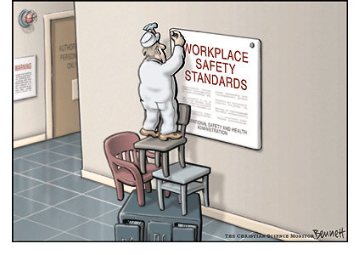
Most employers think they work safe

Slide 65

Insurance Premium Calculations
Safety is built into premium calculation
Classification code(s)
  640+/- in Virginia
  Each has an assigned rate based on industry hazard
Payroll
Experience modifier
  Three year loss history
  Safer employer ⇨ less claims ⇨ lower mod

Slide 66
Policy Details
    factors employer cannot alter
    the factor employer best controls
Occupation | Payroll | Rate | Experience Rating | Basic Manual Premium
Clerical | $200,000 | 0.17 | 0.50 | $1,170.00
Clerical | $200,000 | 0.17 | 1.00 | $3,400.00
Clerical | $200,000 | 0.17 | 1.50 | $5.100.00
Roofing | $200,000 | 25.97 | 0.50 | $25,970.00
Roofing | $200,000 | 25.97 | 1.00 | $51,940.00
Roofing | $200,000 | 25.97 | 1.50 | $77,910.00
    Experience rating is where greatest savings can be realized, or costs added

Slide 67

Drug-Free Workplace
§65.2-813.2 provides for a premium discount of up to five percent (5%) to every employer instituting and maintaining a drug-free workplace program satisfying such criteria as each insurer may establish.

Slide 68
Penalty Considerations

Slide 69
Penalty Considerations
Employers subject to the Act must properly insure
  The civil penalty for failing to insure is up to $250 per day
  Maximum penalty is $50,000.00
Other penalties
  § 65.2-806 provides for criminal penalties for employer who knowingly and intentionally fails to comply with the Act
  § 65.2-902 provides for civil penalty for failure to make any report required of the Commission – fine is not more than $500 for each failure, but up to $5,000 if willful.

Slide 70

Any Other Questions?

Slide 71
Vivian Lane
Claims Services Manager
Suzanne Soule
Assistant Insurance Manager
Virginia Workers’ Compensation Commission
333 East Franklin Street
Richmond, Virginia 23219
Website: www.workcomp.virginia.gov

