Slide 1

Employment Law Updates

Slide 2
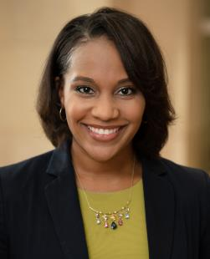


Presented by
Kameron V. Melton
Michael P. Gardner
  Principal
Leah M. Stiegler
  Associate
Associate

Slide 3
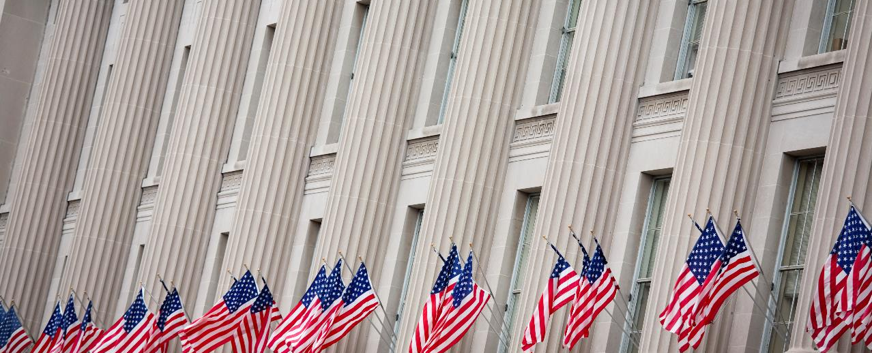
What’s Happening at the . . .
Some of the biggest changes to the legal landscape involve the federal agency enforcement priorities, rules and regulations.

Slide 4

Equal Employment Opportunity Commission
Advances opportunity in workplace
Enforces federal laws prohibiting employment discrimination

Slide 5
Protected Classifications
Federal EEO Statutes
Race
Color
Religion
National Origin
Gender
Pregnancy
Age
Disability
Genetics
Military Status
Title VII
Title IX
ADA
ADEA
GINA
USERRA

Slide 6
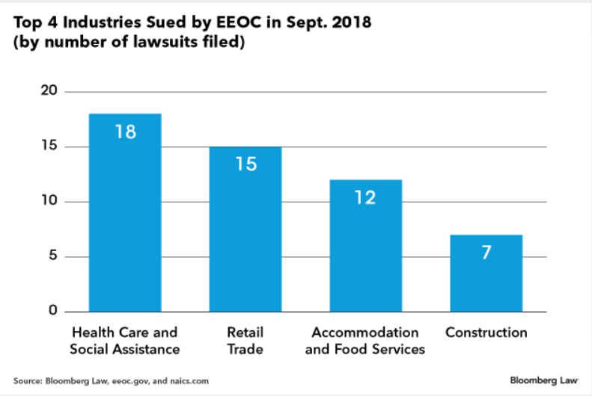
EEOC
21% of EEOC’s actions in Sept. Mostly sexual harassment and disability discrimination

Slide 7
Strategic Enforcement Plan: Updated
2018 is Year 2
Plan released Oct. 2016 for 2017-2021
Prioritizes areas
    Recruitment and hiring barriers
    Protecting vulnerable workers
    Equal pay
    Access to the legal system
    Preventing systemic harassment
Re-affirmed February 2018 for 2018-2022

Slide 8
2017 Enforcement & Litigation

Slide 9
Recent headlines
EEOC reports sharp increase in sexual harassment complaints
  10-4-2018
    From 2017 to now:
    Complaints rose 12%
    EEOC filed 50% more lawsuits
    Recovered $70M in damages, up from $20M

Slide 10

50 Years of the ADEA:
Age Discrimination in Employment Act
Bars discrimination 40 yrs / older
Some states protect younger workers
75% of older workers think age an obstacle to employment

Slide 11
Michigan Department of Health and Human Services
MDHHS runs Kalamazoo Psychiatric Hospital
56-year-old EE had been unanimously recommended by an interview panel for a clinical social worker position; clinical services director instead selected a much younger EE, citing a preference for younger workers.
Same clinical services director supervised another older worker, a 60-year-EE social worker; gave EE less desirable assignments and scrutinized her work closer
10-2-18

Slide 12
urbana SCHOOL district no. 116
EEOC v. Urbana School District No. 116 and Urbana Education Association
  8-13-2018
    EEOC conducted a pre-suit investigation
    Urbana S.D. limited older teachers’ salary increases pursuant to a CBA
    Provision limited salary increases of teachers within 10 years of retirement eligibility to no more than 6%
    EEOC position: “Setting salaries based on age is age discrimination, plain and simple, and violates federal law."

Slide 13
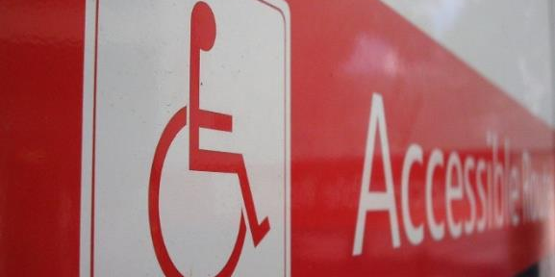
Disability
ER or other entity covered by the ADA treats a qualified EE/applicant with a disability unfavorably

Slide 14
Health Partners, Inc. To Pay $25,000
Refusing to allow an EE to start working after she tested positive for tuberculosis on a preliminary skin test.
EEOC: Health Partners violated ADA she was not contagious and did not pose a direct threat of health risk but it regarded her as having a disability.
Per­ceived disabilities count too!

Slide 15
Steel Painters
EEOC v. Steel Painters, LLC
  6-29-2018
      EE dependent on opioid medication in past but was in treatment for over 1 year
      When hired, EE taking a dose of prescribed methadone after work day
      EE took required pre-employment drug and alcohol test that came back "positive”
      Lab cleared him based on methadone prescription
        "Opioid addiction is a disability that is affecting millions across the United States, yet many are regaining control over their lives by participating in supervised rehabilitation programs."

Slide 16

Equal Pay
Requires women and men be given equal pay for equal work

Slide 17
Is there a Pay-Gap Problem in Health Care?
2016 - Journal of the American Medical Association
  Analyzed 10k salaries of physicians . . . Women made $51k LESS than male counterparts
2018 Study by Doximity
  Analyzed 65k salaries of physicians . . . Women made 27.7% LESS than male counterparts (or about $105k less per year)
  Drs. are not alone . . . Nurses were found at a 10:1 ratio

Slide 18
Equal pay act
March 2018
U.S. EEOC v. Md. Insurance Admin. – SCOTUS
    Was a district court correct in granting summary judgment for the ER in an EPA suit?
      EEOC sued on behalf of 3 female EEs
      ER argued that pay disparity based on gender neutral criteria
      4th Cir. ruled ER can only avoid EPA liability if it shows its reasons in fact explain the wage gap
        Gender disparity claims can survive summary judgment even if gender neutral criteria are used

Slide 19
How to Address It?
Should you conduct a pay audit?

Slide 20
University of Denver
EEOC et al. v. University of Denver
  6-1-2018
    Female professors at University's Sturm College of Law paid avg of $20,000 less than male counterparts
      University violated federal law by paying female professors lower salaries than male counterparts
      Salaries of female professors were on average, $19,781 less
      Despite recognizing pay disparity in a memo, university declined to take corrective action
        University will pay $2.66 million and furnish other relief

Slide 21

Pregnancy
Amendment to Title VII
of the Civil Rights Act of 1964
Prohibits discrimination on the basis of pregnancy, childbirth, or related medical conditions

Slide 22
Pruitthealth
Pruitthealth Sued by EEOC for Pregnancy Discrimination
  4-18-2018
      Offered job modifications to CNAs injured at work
      Refused similar accommodations for pregnant CNA
      ER had device to help lift patients, did not prohibit CNAs from seeking assistance
      Forced her to resign or be fired
        "Companies must be careful not to violate federal anti-discrimination law when they pick and choose which employees to accommodate."

Slide 23

Religion
Treating EE/applicant unfavorably because of religious beliefs
Law covers not only traditional, organized religions but also sincerely held religious, ethical or moral beliefs

Slide 24
United Health Programs of America
EEOC v. United Health Programs of America
  4-26-2018
      EEs forced to engage in religious practices at work
      Prayer, religious workshops, spiritual cleansing rituals
      Part of a belief system called "Harnessing Happiness" or "Onionhead," created by CEO’s aunt
      Violated federal law by coercing 10 employees to engage in religious practices at work
        Jury awarded $5.1 million for workers.

Slide 25

Religious & Sex Discrimination?
Former Miami Dolphins cheerleader Kristan Ann Ware filed a lawsuit Wednesday against the Dolphins and the NFL
Post areosted a picture of her being baptized on social media.
During an annual performance review, two coaches told her not to discuss her virginity
Double Standard?
“I got told things like you can’t mention God. I felt like I was walking on eggshells. But a football player can publicly announce whatever they believe like kneeling for political indifference or kneeling because he does have a relationship with God and he wants to pray he as a right to do that.”

Slide 26
Religious Discrimination?
What about the Flu Shot issue?

Slide 27
Saint Thomas Health Sued by EEOC For Religious Bias
STH required all workers at the Hospital to have an annual flu shot, including food and environmental services EEs at the hospital.
2013/2014: STH allowed plaintiff EE to wear a protective mask instead of having a flu shot (due to EE’s religious belief).
2015: request denied. Terminated upon refusal.
What is the problem here? Isn’t this a legitimate business reason?!

Slide 28

Sex Discrimination
Treating EE/applicant unfavorably because of person's sex
Discrimination because of gender identity, transgender status, or sexual orientation

Slide 29
The Children’s Home
The Children’s Home Settles EEOC Sex Discrimination Lawsuit
  5-2-2018
    Refused to Hire Male EE for a Maternity Program Position
      ER refused to consider male EE based on his sex
      After voicing concerns, EE prevented from applying to other positions
        "Outdated stereotypes about the roles of men and women in child care and caregiving should not adversely impact employees' job prospects."

Slide 30
What does SEX mean?

Slide 31
EEOC LGBT Charge Filings
2013 | 2014 | 2015 | 2016 | 2017
808 | 1,100 | 1,412 | 1,768 | 1,762
Increase of nearly 120% in 5 years!

Slide 32
Look-Back: Evans
Evans v. Georgia Regional Hospital
  7-24-2017
      EE alleges that ER discriminated against her on the basis of sexual orientation and gender nonconformity, in violation of Title VII
        11th Cir. Ct. of Appeals denies EE’s claim, holding that Title VII does not protect against sexual orientation and gender nonconformity discrimination.

Slide 33
Altitude Express
Zarda v. Altitude Express
  2-26-2018
      Gay EE fired after customer complaint
      EEOC reiterated arguments from Hively
      2nd Cir. Ct. ruled Title VII prohibits sexual orientation discrimination
        "Sexual orientation discrimination is a subset of sex discrimination because sexual orientation is defined by one's sex in relation to the sex of those to whom one is attracted."

Slide 34
LGBT Employment rights
Expanded in recent years… and retracted
DOJ
    Title VII does not cover employment "discrimination based on sexual orientation."
EEOC
    Title VII prohibits sexual orientation and gender identity discrimination
Courts
    Issue likely decided by SCOTUS (2,6,7 vs. 11 Circuits)
Congress
    Unlikely to act before SCOTUS

Slide 35
What’s Happening at the . . .
Some of the biggest changes to the legal landscape involve the federal agency enforcement priorities, rules and regulations.

Slide 36

Dept. of labor
Fosters, promotes, and develops welfare of wage earners, job seekers, and retirees

Slide 37
Covered by DOL
Fair Labor Standards Act (FLSA)
Family and Medical Leave Act (FMLA)
Office of Federal Contract Compliance Programs (OFCCP)
Service Contract Act (SCA)
Davis-Bacon Act

Slide 38
Overtime Rule
Current Overtime Exemptions
Proposed Overtime Rule
Salary Level | > $455 weekly or > $23,660 annually
Category | Executive Administrative Professional Computer EE Outside Sales Highly-Compensated
Standard Duties Test | See WHD Fact Sheet #17A.
Exclusions | Blue Collar Workers First Responders
  Announced plans on October 30, 2017 to undertake new rulemaking
  Hosting “listening sessions” across U.S. Sept. 7 through 24, 2018

Slide 39
New Pilot “PAID” Program
Payroll Audit Independent Determination
Goals
    Facilitate resolution of potential O/T and min. wage claims
    Resolve claims quickly, without litigation
    Improve ER’s compliance with O/T and min. wage laws
    Ensure EEs receive back wages they are owed faster
Pilot program to last 6 months
https://www.dol.gov/whd/paid/

Slide 40

Fair Labor Standards Act
Establishes minimum wage, overtime pay, recordkeeping, and child labor standards
Wage and Hour Division (WHD) administers and enforces

Slide 41
Fair Labor Standards Act
Encino Motors v. Navarro - SCOTUS
  4-2-2018
    Are service advisors at a car dealership exempt?
      FLSA exempts “salesman, partsman, or mechanics primarily engaged in selling or servicing automobiles, trucks, or farm implements”
      S.C. determined service advisors are exempt as a type of salesman selling auto repair
    S.C. rejected longstanding view of “narrowly construed” FLSA exemptions
      Important for ALL industries because it opens door for broader interpretation of FLSA exemptions

Slide 42
Opinion Letters return
Travel Time
  4-12-2018
    General Rule: Time spent as a passenger compensable when it falls during employee’s normal working hours, without regard to day of week
      But what if EE works different hours and durations
    3 options for ERs
      Look at most recent month to determine “typical work hours”
      Average start and end times.
      Work with EE to come to a practice that is agreed-upon in advance

Slide 43
Opinion Letters Return
Frequent Rest Breaks
  4-12-2018
    Does ER have to compensate EEs that need frequent breaks due to continuing serious health conditions under FMLA?
    Gen. Rule: rest breaks up to 20 minutes in length are ordinarily compensable (because they benefit ER)
      In limited circumstances, short rest breaks primarily benefit EE and are not compensable, and FMLA leave may be unpaid
    15-min FMLA breaks can be unpaid but EEs who take FMLA-protected breaks must receive as many paid rest breaks as their coworkers.

Slide 44

Opinion Letters Return
Time Spent Attending Employer-Sponsored Benefits Fairs
  8-28-2018
    Does ER have to compensate EEs for voluntarily attending ER-sponsored wellness activities?
    Since ER receives no direct financial benefit, and EE relieved of job duties during voluntary activity, it’s not compensable “work.”

Slide 45
Wage and Hour Division
7/13/18 Field Assistance Bulletin
Question: When are home care, nurse, or caregiver registries “ERs” under the FLSA?
Answer: case-by-case basis
  A registry that simply facilitates matches between clients and caregivers is not an ER unless registry is involved in aspects like hiring, firing, scheduling, training, licensing (i.e. a more “hands-on” approach to directing the work of the caregivers)
  E.g., Performance of basic caregiver background checks does not indicate ER status. BUT if the registry actually interviews prospective caregivers or references, or pre-selects candidates for clients, however, it may be acting as an ER

Slide 46
Presented by
Kameron V. Melton
Associate
Michael P. Gardner
  Principal
Leah M. Stiegler
  Associate

