Slide 1
Employee Misconduct:
Investigations, Discipline and Discharge
VEC 2019 Employer Conference
Randy C. Sparks, Jr.
Kaufman & Canoles, P.C.

Slide 2
Employee Satisfaction and Engagement
89% of U.S. employees are “satisfied” with their jobs
  Very Satisfied = 38%
  Somewhat Satisfied = 51%
WHY?
Source: 2017 SHRM Employee Job Satisfaction and Engagement Survey

Slide 4
Individual Liability
Few federal statutes impose individual liability. FLSA, and maybe EPA, but not Title VII and ADA.
“Wrongful termination of employment” state tort: individual liability for “an individual who was not the employer but who was the actor in violation of public policy and who participated in the wrongful firing.” VanBuren v. Grubb, November 1, 2012

Slide 5
Three Phases of Discipline
1. Preparation
2. Documentation
3. Delivery

Slide 6
Phase One: Preparation
Purpose of discipline
Can this employee be salvaged?
  Economic obligation
  Moral obligation
What additional information is needed?

Slide 7
Preliminary Steps
  Prepare the investigation plan.
  Assess the risk and act accordingly.
  Discuss the parameters of the investigation.
  Determine a timely deadline for completing the investigation.
  Establish steps necessary to maintain confidentiality.

Slide 8
An Investigation Plan
    Determine who will conduct interviews of the complaining employee, the accused, and the witnesses or other involved individuals.
    Determine who needs to be interviewed and in what order.
    - Identify and interview all named or potential witnesses
    Interview anyone who may be familiar with similar incidents or who may have insight into, or information concerning, the situation.
    Determine the third party to be present during interviews.

Slide 9
Create a File of Documents to Be Reviewed
    Company policies and procedures concerning harassment, investigation, privacy and discipline.
    Employment records of the complaining employee and the alleged offender should be reviewed thoroughly for records of prior complaints or other disciplinary actions.
    The written complaint, if any.
    Memorandum or notes about the incident(s), including manager’s notes and files.

Slide 10
Protective Measures
Interim security to safeguard coworkers
Interim computer monitoring issues to safeguard intellectual property
  Monitor emails
  Monitor downloads
Protect yourself
  More on this later

Slide 11
Phase Two: Documentation
All complaints or infractions
Investigations
Reasons for decisions
Decision makers and dates
Review file objectively

Slide 12
Complaints
In writing
  Details forgotten when oral only
  To the extent possible, documentation should be in a form independent of the availability of witnesses
Complaint documentation should speak for itself
Print names legibly, use titles, identify decision makers

Slide 13
Starting an Investigation
Understand the documentary record
Decide the order of witnesses to interview
  Should accused come first or last?
Prepare questions before the interview
  – Do not tie yourself to the script
  Remind interviewee you will be objective
  Remind interviewee you will not retaliate

Slide 14
Conducting an Investigation
APPEAR impartial and BE impartial
Gather information
Do not be confrontational or accusatory
Assure the accused employee her or his side will be heard, decision will be careful and prompt

Slide 15
Prepare a Detailed Outline of Key Questions
      Get the facts, focusing on what the witness saw, heard, did or felt.
      Begin with open-ended questions.
        Move from general to specific questions.
      Try to move chronologically.
      Distinguish personal knowledge from hearsay.
      Follow-up on answers given with appropriate additional questions in order to get the facts, not just conclusions.
      Determine if objective or written confirmation exists.

Slide 16
Interview Witnesses
        Tell the employee that an investigatory interview is being conducted, and the subject matter of the investigation.
        Do not promise confidentiality.
        Ask for details.
        Exactly what happened?
        When did it happen?
        Where did it happen?
        Who was present?
        What was said or done?
        Do you have any evidence?

Slide 17
Proper Note-Taking Techniques
      Avoid recording your own opinions or conclusions.
        Start a new page for each interview, noting the names of those present and the date, time, and place of the interview.
        At the end of an interview, review the key points in your notes with the witness to confirm accuracy and to assess whether the witness has additional information.

Slide 18
Create a Document File
        The complaint;
        The investigator’s daily log, including telephone log;
        All communications to and from witnesses;
        Draft and final witness statements;
        All documents collected as evidence that either establishes or refutes the issues investigated; and
        Documentation of the investigation’s result.

Slide 19
Promises Made, Promises Broken
Don’t make promises
  We will keep this confidential
  I’m sure it was just a misunderstanding
  Please don’t worry about being fired
  We should wrap this up in a week
Promises are unenforceable BUT
Create misunderstanding, anger, animosity, and litigation

Slide 20
Psychology and Self-Preservation
Don’t humiliate anyone
  Private interviews are best (see caveat below)
  Don’t pit employee against employee
  Don’t encourage employees to “work it out”
NO solo interviews
  Second person does not participate
  Takes notes, observes, witnesses

Slide 21
Conclude the Investigation
Document the reason for any decision
  Don’t fudge
  Don’t lie
  Recognize multiple reasons if they exist
  Refer to specific facts for conclusions
  But do not – ever – make legal conclusions!
  “It was sexual harassment!”
  “It was not sexual harassment!”

Slide 22
Be Succinct and Clear
Document the decision itself
  Document stating “Dan was fired July 20” is not ambiguous
  For lesser discipline, state that employee has received copy of personnel action
  Allow the employee to provide one written response ONLY
  End it there!

Slide 23
Disciplinary Documents Should Be Written In Such A Way That A “Stranger” Could Read And Understand
Sequence of Events
Why Conduct Did Not Meet Standards
Required Corrective Action
Time Frame
Consequences

Slide 24
Phase Three: Delivery
What – Termination or lesser?
Who delivers?
Where?
When?

Slide 25
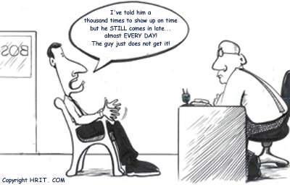
IMPLEMENTING DISCIPLINE
Explain Reasons
Hear Employee’s Side
Explain How to Improve
Explain Consequences

Slide 26
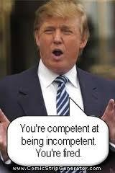

Slide 27
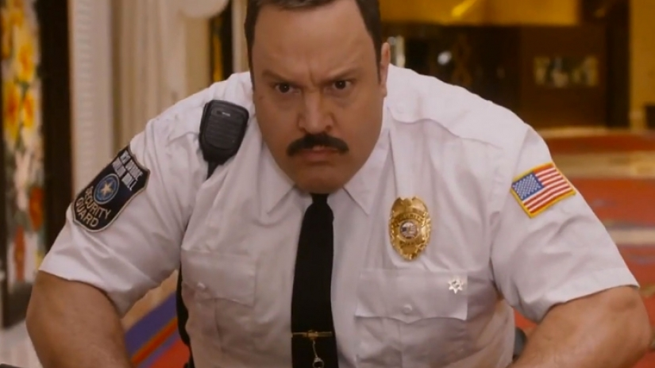
Security

Slide 28
Protect Yourself …
If you’re paranoid, good!

Slide 29
Avoid Lawsuits
Know the law
Follow the law, not necessarily your supervisor’s orders
Policies up to date, and follow them
Due diligence
Document ALL actions
  “If it’s not in the file, …”

Slide 30
Avoid Lawsuits
Communicate with employees
  Dignity and respect
Have a witness
Respond promptly and properly to authorities
Consult your employment lawyer early and often

Slide 31

DOCUMENT, DOCUMENT, DOCUMENT

Slide 32
Specific Suggestions for Firing an Employee

Slide 33
Give a Warning Rather than Terminating if Warranted

Slide 34
Review Employee’s Hard Drive and Computer Systems for Violations of Company Policy

Slide 35
Don’t Go it Alone!

Slide 36
Be Consistent!

Slide 37
During the Termination Meeting …
Be Brief and to the Point
Don’t Debate
Retain Control

Slide 38
Avoid Saying These Things
“How’s the family?”
“I’m sure you’re surprised.”
“I know how you feel.”
“Let me know how I can help.”
“Take all the time you need.”
“This isn’t personal; it’s just business.”
“You’re just a bad fit here.”

Slide 39
Consider a Release, and Give Severance as Consideration if Appropriate

Slide 40
Consider Whether to Oppose Claim for Unemployment Benefits

Slide 41
Details, Details
Revoke purchasing authority
COBRA, 401(k)
Other benefits
Legal notices

Slide 42
Calendar Deadlines
300 days to file EEOC charge
Unemployment Compensation
Statute of limitations for common-law claims

Slide 43
QUESTIONS?

Slide 44
Thank You!
Randy Sparks
rcsparks@kaufcan.com
(804) 771-5709

