Slide 1
Veterans and your Bottom Line
Jeff Brown, Director of Workforce Services

Slide 2
Do You Really Want to Hire a Vet?

Slide 3
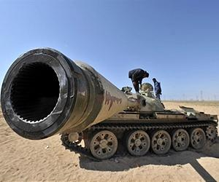
Why Some Companies Avoid Hiring Vets
Skill Translation/Mismatch

Slide 4
Why Some Companies Avoid Hiring Vets
Negative Stereotypes

Slide 5
Why Some Companies Avoid Hiring Vets
Future Deployments

Slide 6
Why Some Companies Avoid Hiring Vets
Acclimation

Slide 7
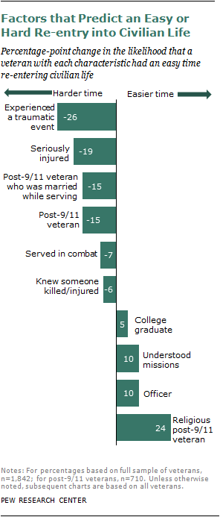

Slide 8
Why Some Companies Avoid Hiring Vets
Ready Availability

Slide 9
Advice to Transitioning Service Members
Remember that you’re not in Kansas anymore, Toto.
Don’t plan to overhaul the organization on day one.
Learn the civilian language of your career.
You may have to get over yourself.
Plan to work effectively across the generations.
Be a company rainmaker.
Mind your digital dirt.
Source: ClearnceJobs.com

Slide 10
Will Your Company Benefit from Hiring Vets?

Slide 11
Will Your Company Benefit from Hiring Vets?
Leadership
Teamwork
Character
Discipline & Structure
Dynamic/High-pressure Environment
Effectiveness
Loyalty

Slide 12
Will Your Company Benefit from Hiring Vets?
Innovative Thinking
Critical thinking
Resilience
Adaptability
Speaking Truth to Power
Background Checks/Security Clearance
WOTC

Slide 13
Will Your Company Benefit from Hiring Vets?
Diversity in Action
Healthy Respect for Policy/Procedures
Technologically Savvy
Tuned-in to Health and Safety Concerns
Unafraid of Adversity
Strong Communication Skills

Slide 14
Think You Want to Hire a Vet?
Are you looking to hire employees now?
Is senior management educated about and committed to hiring and retaining vets?
Do you have a robust, dedicated and accessible training/onboarding program?
Does your company have an established career progression ladder?
Can you pay at least $25K/year with benefits?

Slide 15
Resources for Recruiting Vets
VEC Local Veterans Employment Representatives
Guard and Reserve Units
Military Affairs and ROTC Offices at Colleges and Universities
“Hero to Hired” Website (H2H.jobs)

Slide 16
Formal Military Messaging using STANAG 4406 (& STANAG 4406 Annex E)
STANAG 4406 is the NATO Standard for formal military messaging, replacing the older ACP 127 specification. Used for both Strategic and Tactical messaging, STANAG 4406 has a number of special protocols to support tactical messaging, in particular to support very low bandwidth links such as HF radio (STANAG 4406 Annex E) and to support receivers in Emission Control (EMCON) mode who can receive but not send data.

Slide 17
Good Job Description
ACME Widgets Basic Qualifications:
Bachelor's Degree or Military Experience
2 years of experience in managing communications to wide variety of audiences business-writing, managing a newsletter or similar type of communication vehicle, editing
1 year of project leadership or project coordination
2 years of experience in Microsoft Office Products (Outlook, Word, Power Point)
Preferred Qualifications:
Bachelors Degree in Mass Communications, Marketing, Public Relations, English
3 years of experience in managing communications to wide variety of audiences
Experience in business-writing, managing a newsletter or similar type of communication vehicle, editing
Experience in Developing communication strategy for department or company
Experience in collaborative team environment
Experience in web publishing software and writing for the web

Slide 18
Not-So-Good Job Description
ACME Widgets is seeking a Marketing Communications Specialist! Job Description:
Champions the customer experience and brand in every servicing communication we sent to customers
Leads meetings with key stakeholders to understand business intent and legal requirements for servicing communications
Collaborates with and provides feedback to copywriter to ensure a positive customer experience, while meeting communication objectives
Coordinates and organizes any internal documentation to ensure the timely and smooth production of communications
Creates research opportunities to improve communications
Initiates recommendations to improve routing and creative process and ways of improving the overall efficiencies

Slide 19
Useless Job Description
At ACME Widgets You Will Grow Further. Our growth and success creates an unparalleled path for you: broader choices, faster learning, and rapid advancement. The success of our clients, our people, and our company is built on customized change, deep insights, and open collaboration, stripped of templates, pretense, and hierarchy.

Slide 20
Making the Match – And Making It Stick!
Carefully consider your job descriptions
Make onboarding a priority, and ask newly hired vets what they need to be successful.
Listen to what vets say about your workplace culture and take their comments seriously.
Focus on your bottom line!

