Slide 1
Labor Market Data for Charlottesville MSA
Donald P. Lillywhite
Director, Economic Information Services
Notes:
This template can be used as a starter file for presenting training materials in a group setting.
Sections
Sections can help to organize your slides or facilitate collaboration between multiple authors. On the Home tab under Slides, click Section, and then click Add Section.
Notes
Use the Notes pane for delivery notes or to provide additional details for the audience. You can see these notes in Presenter View during your presentation.
Keep in mind the font size (important for accessibility, visibility, videotaping, and online production)
Coordinated colors
Pay particular attention to the graphs, charts, and text boxes.
Consider that attendees will print in black and white or grayscale. Run a test print to make sure your colors work when printed in pure black and white and grayscale.
Graphics, tables, and graphs
Keep it simple: If possible, use consistent, non-distracting styles and colors.
Label all graphs and tables.

Slide 2
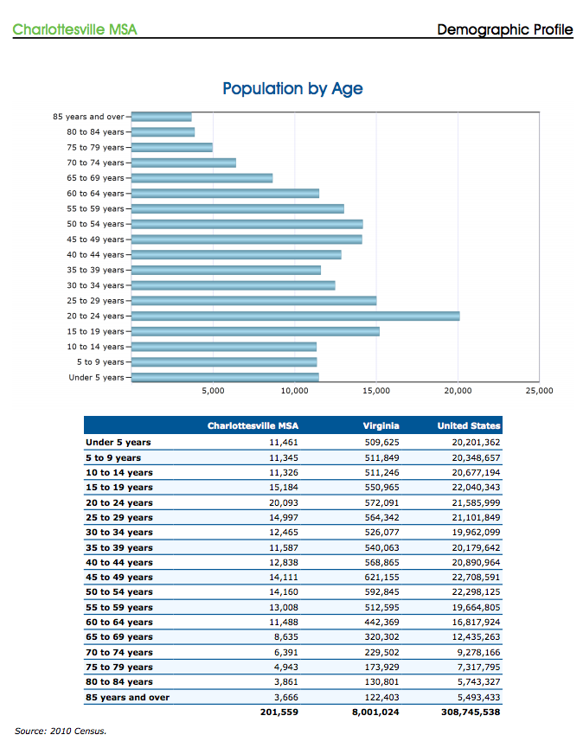
Notes:
Give a brief overview of the presentation. Describe the major focus of the presentation and why it is important.
Introduce each of the major topics.
To provide a road map for the audience, you can repeat this Overview slide throughout the presentation, highlighting the particular topic you will discuss next.

Slide 3
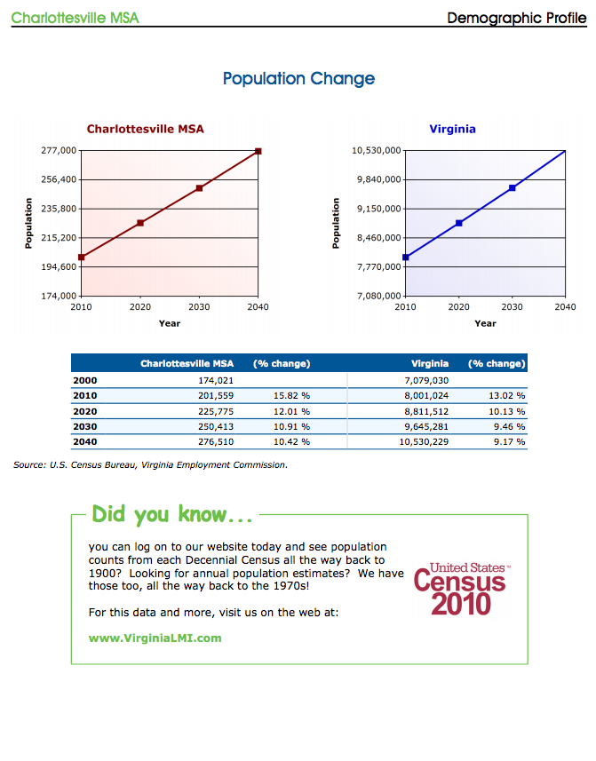

Slide 4
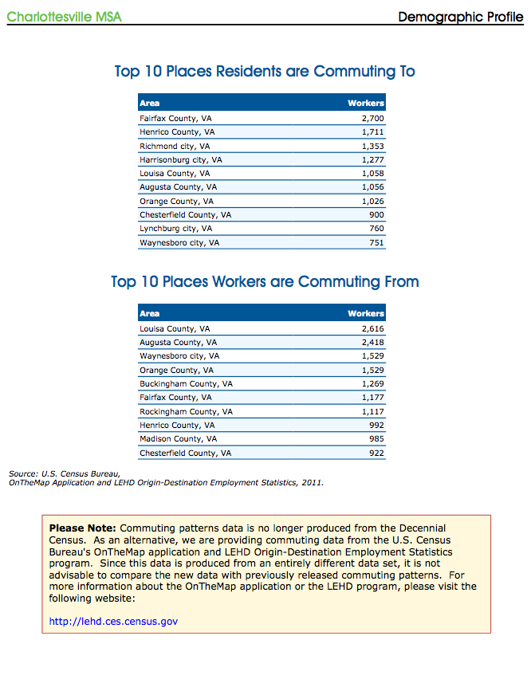

Slide 5
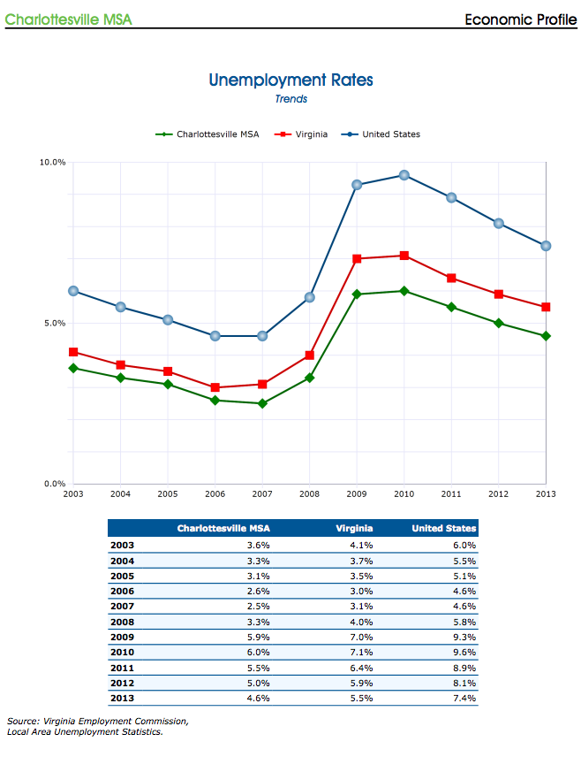

Slide 6
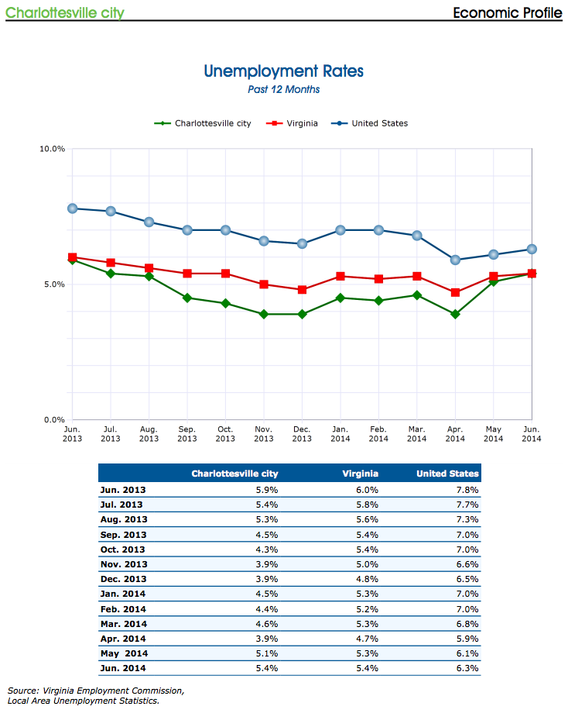

Slide 7
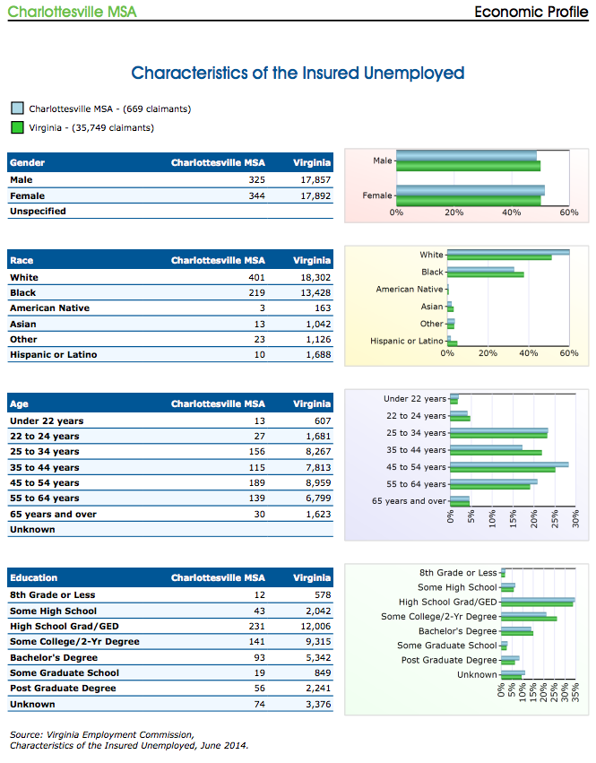

Slide 8
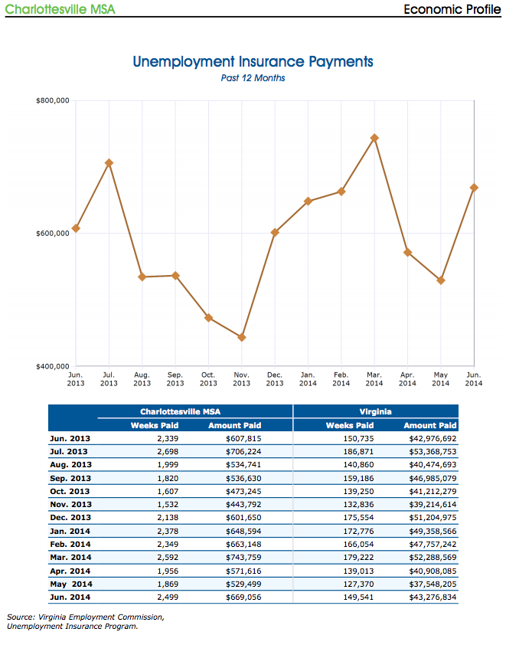

Slide 9
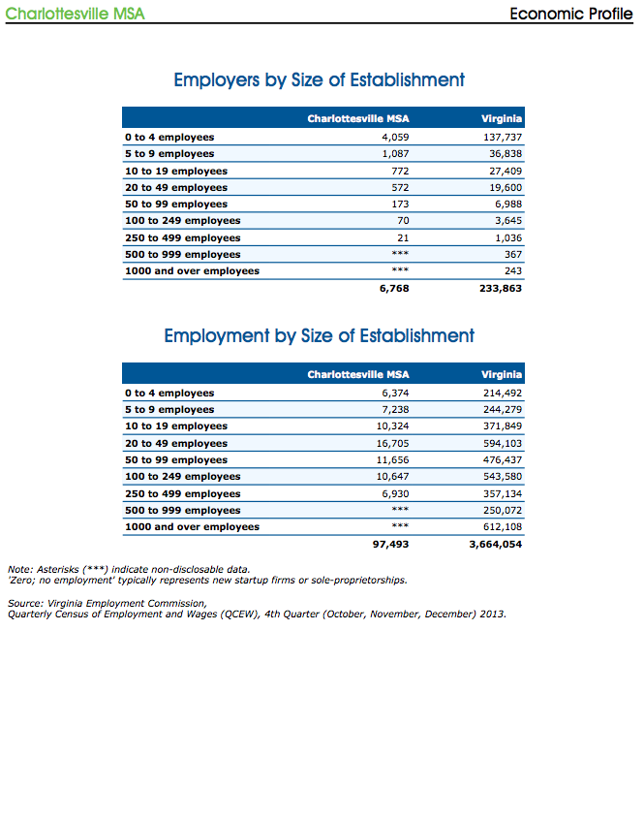

Slide 10
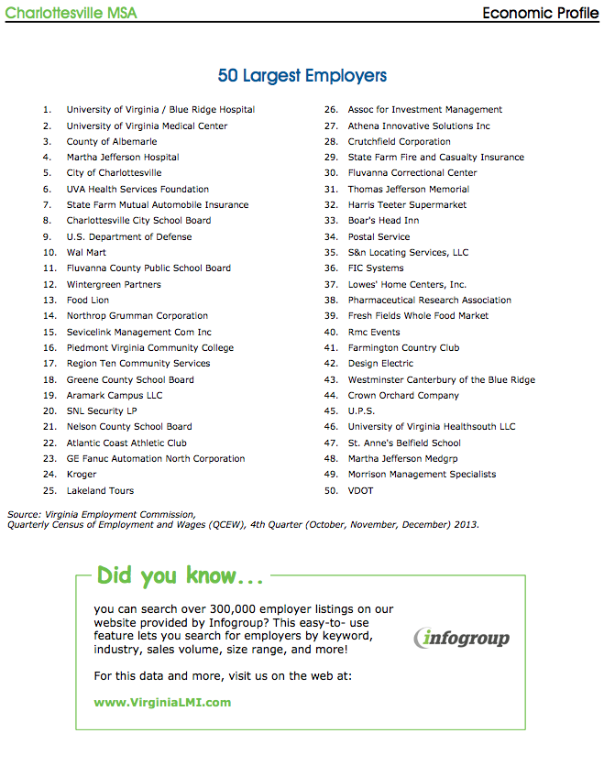

Slide 11
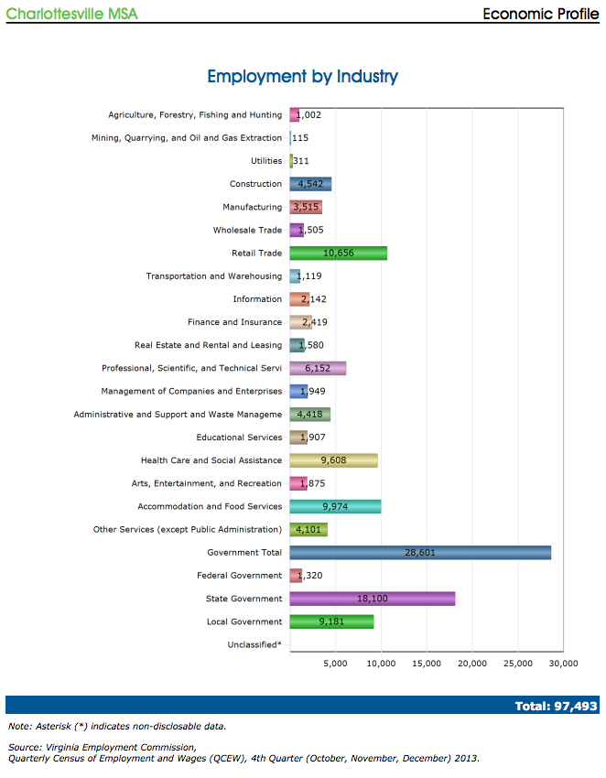

Slide 12
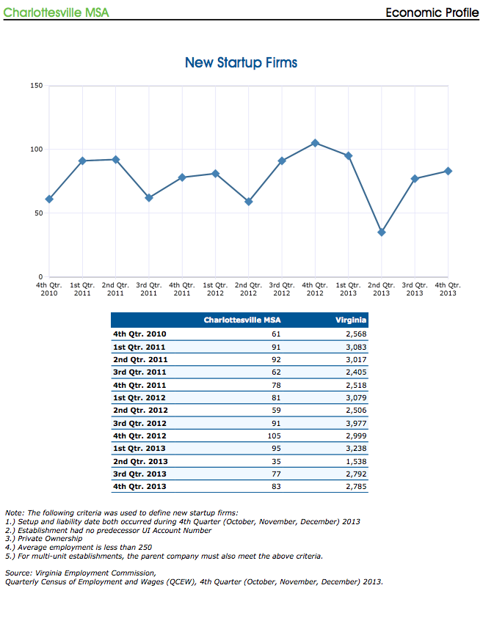

Slide 13
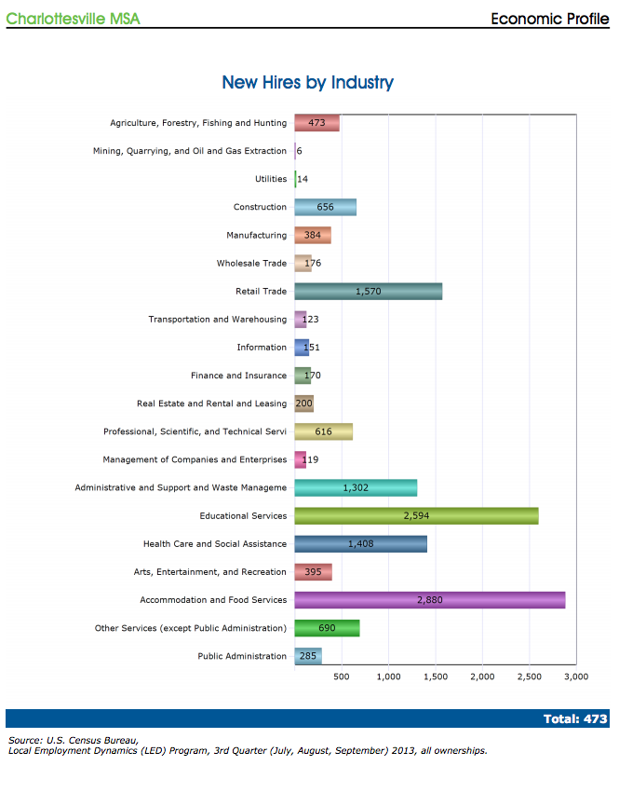

Slide 14
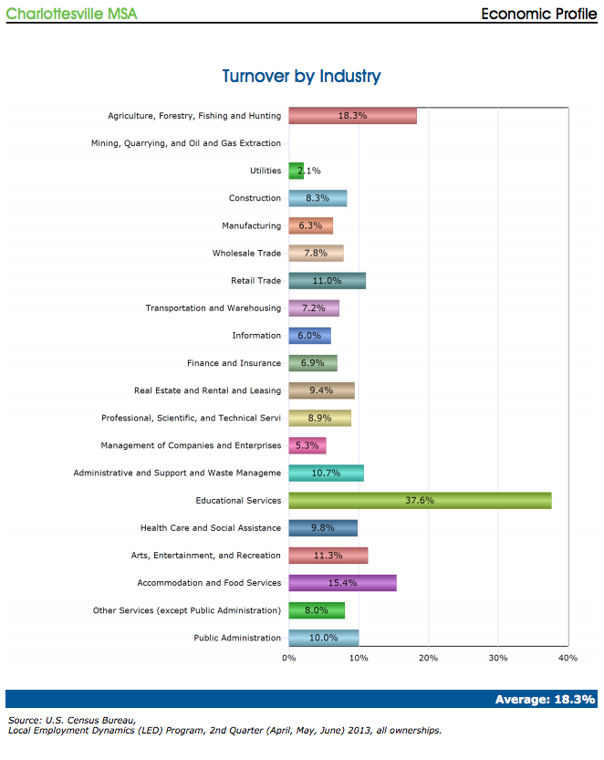

Slide 15
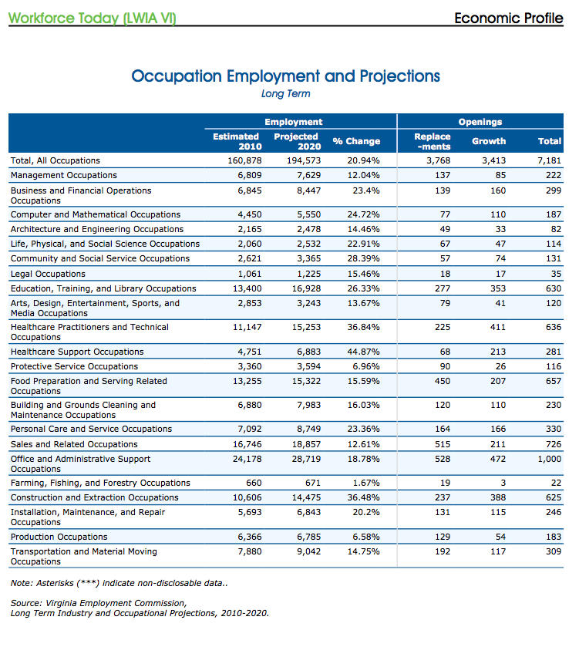

Slide 16
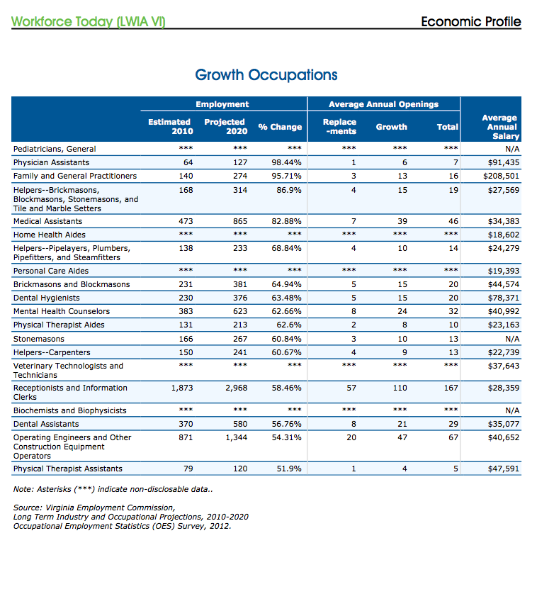

Slide 17
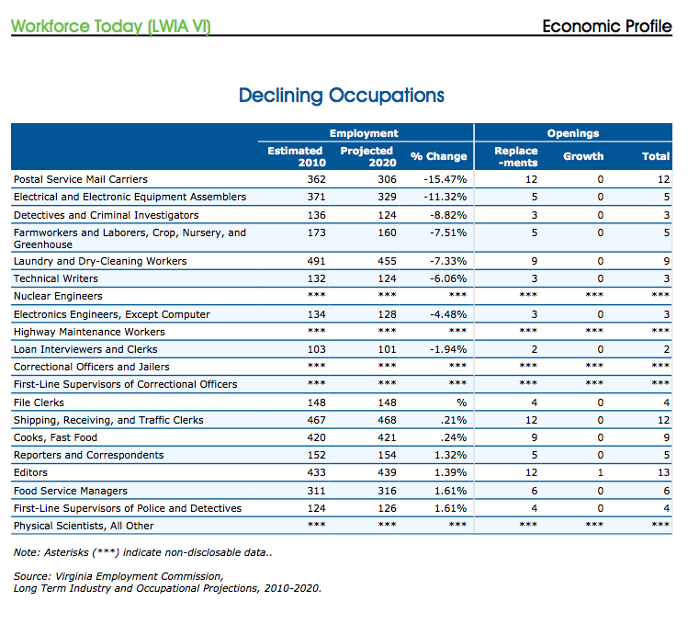

Slide 18
